Slide 1
Smooth Path Planning in Constrained Environments
Author: Martin Rufli, Dave Ferguson, Roland Siegwart
------Autonomous System Lab ETH Zurich

Slide 2
Smooth Path Planning
in Constrained Environments
1
【INTRODUCTION】
2
【SEARCH OVER A STATE LATTICE】
3
【REDUCTION OF SEARCH COMPLEXITY】
4
【RESULTS】
5
【CONCLUSION】

Slide 3
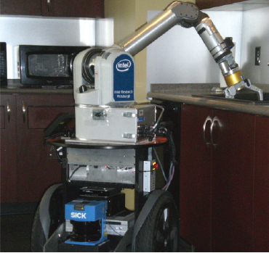
Introduction
The main contribution of this paper is a navigation approach that produces smooth, complex maneuvers over large distances.
Use the ground vehicle Herb with a laser scanner and can update data of the situation for test.
The Grid-based Algorithm
  Use anytime A* gragh search
  Use multi-resolution state lattice
  Offline precomputation
  Online replanning
Notes:
5

Slide 4
Shortcomings of algorithm before
Autonomous vehicles are often required to navigate through cluttered, dynamic, and unstructured environments.
To provide responsive vehicle behavior in dynamic environments, the time spent performing this planning is required to be minimal.
Paths returned by such global grid based algorithms, although optimal on the grid, are often not achievable due to vehicle constraints.
Other issues lie in the limited number of headings standard gridbased planners allow and their prohibitive execution times in higher dimensional search spaces

Slide 5
Search Over a State Lattice
Multi-Resolution Lattices
Use cubic splines, represented via the Catmull-Rom parametrization, resampled for constant path length.
Configuration space: 4D(x,y,θ,v)
Environmental Characteristics
Task Characteristics

Slide 6
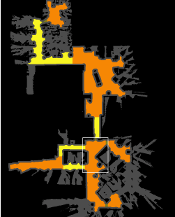
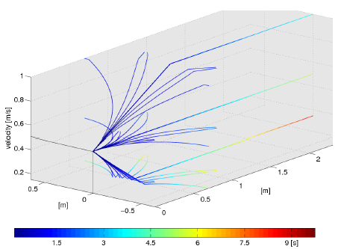
Search Over a State Lattice
An example of a segmented environment

Slide 7
Search Over a State Lattice
Search Over the Lattice
Use Anytime A* gragh search algorithm
Heuristic generation: Perform a Dijkstra search out from the goal location so that the cost values become the heuristic values.
Representation of dynamic obstacles:Currently detect the dynamic obstacles via laser readings and store them in the same way as static obstacles.

Slide 8
Reduction of
Search Complexity
Orthogonal Structures
In indoor environments, walls are usually oriented orthogonally to each other. In such areas, the lattice angular discretization may be reduced: four discrete values would theoretically suffice.
A simple approach for strictly orthogonal environments is to find the dominant directions of the environments via line fitting techniques, and then rotate either the maps or the lattice accordingly. A more general approach for arbitrarily oriented environments is to first compute a low-fidelity trajectory then construct a highfidelity solution by minimizing a cost function that takes into account dominant directions in the trajectory’s local environment

Slide 9
Reduction of
Search Complexity
Segmented Environments
Segmentation
Offline trajectory precomputation phase
Online heuristic value generation phase
Online intra-room planning phase
Real-time heuristic recomputation

Slide 10
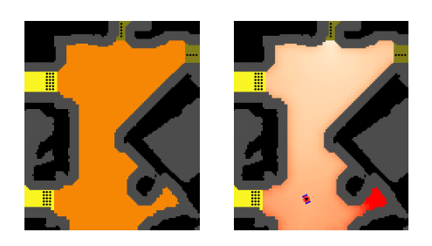
Reduction of
Search Complexity
Left: enlargement of the boxed area in Fig. 2-Left. Offline, a look-up table with trajectories between every pair of nodes adjacent to the same room is stored (trajectories are not shown). Right: online 2D heuristic computation. For an assumed goal towards the top, a 2D heuristic is computed. Darker reds represent higher expected cost to the top door.

Slide 11
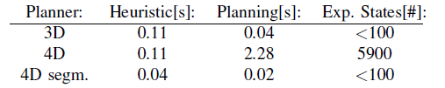
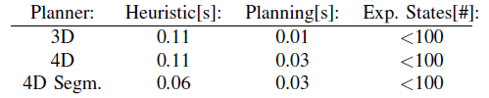
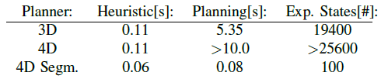
Results
Long Run Through the Entire Lab
Short Run in a Single Room(Unoccupied)
Short Run in a Single Room(Blocked Preferred Path)

Slide 12
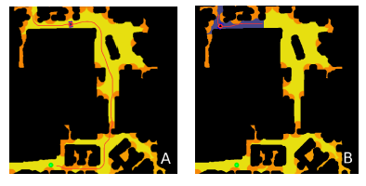
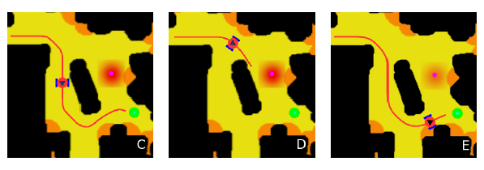
Results

Slide 13
Conclusion
In this paper, they presented a novel multi-resolution state lattice for smooth navigation in indoor environments. Furthermore, they presented a novel approach for generating fast globally optimal trajectories in constrained spaces. This approach exploits offline pre-computation to provide extremely efficient online performance and is applicable to a wide range of both indoor and outdoor navigation scenarios.
Their segmented environment approach was shown to provide significant advantage in such scenarios, where existing approaches are unable to provide solutions in the required deliberation time.

Slide 14
Thank You!

